Slide 1
Amazon Sales Data Overview: 2010-2017
“This Presentation Offers a Comprehensive Analysis Of AMAZON’S Sales Data From 2010 to 2017. We Will Explore Significant Trends, Profitability , Product Performance, Geographical Distribution, And Customer Insights.
Additionally, We Will Analyze The Competitive Landscape And Provide Actionable Recommendations For Future Growth.

Slide 2
Data Cleaning and Transformation
Data Cleaning:
Duplicate Removal: Ensured the uniqueness of each sales entry.
Missing Value Handling: Imputed or removed entries with missing data to preserve dataset integrity.
Format Standardization: Maintained consistency in date, region, and item type formats.
Data Transformation:
Column Additions:
Month: Extracted from the date field to analyze monthly trends.
Year: Extracted from the date field for yearly trend analysis.
Month-Year: Combined month and year to create a 'Month-Year' column for detailed trend analysis.
New Metrics:
Total Sales by Month : Aggregated sales data to evaluate monthly performance.
Total Sales by Year: Summarized sales data for annual comparisons.
Total Sales by Month-Year: Detailed measurement to identify sales patterns over specific periods.

Slide 3
Introduction:
Objective:
"This report provides a comprehensive analysis of Amazon's sales data from 2010 to 2017."
Key Metrics :
Total Sales : 39.01M
Total Revenue : 58.25M
Total Profit : 19.25M
Total Average Profit : 384.95k

Slide 4

Regional Sales Distribution
Major Regions :
North America
Europe
Africa
Asia
Australia
South America
Key Insights:
Highest Sales : North America
Notable Performance in Europe and Asia
Emerging Markets in Africa and South America

Slide 5
Sales Channels Breakdown
Channels :
Offline
Online
Analysis Period : 2010 - 2017

Slide 6
Item Type Sales Breakdown
Top Item Types:
Meat : 11K
Snacks :14K
Vegetable : 15K
Baby Food :16K
Beverages :15K
Cereal : 22K
Office Supplies :26K
Cloths :30K
Fruits :36 K
Cosmetics : 42K
Household : 282

Slide 7
Monthly Sales Trends
High Sales Months :
February
November
April
Low Sales Months :
January
December
September

Slide 8
Annual Sales Trends
Peak Year : 2012 (Over 9.2 M in Sales)
Sales Performance : Steady Growth From 2010 to 2012 , Followed by Fluctuations.

Slide 9
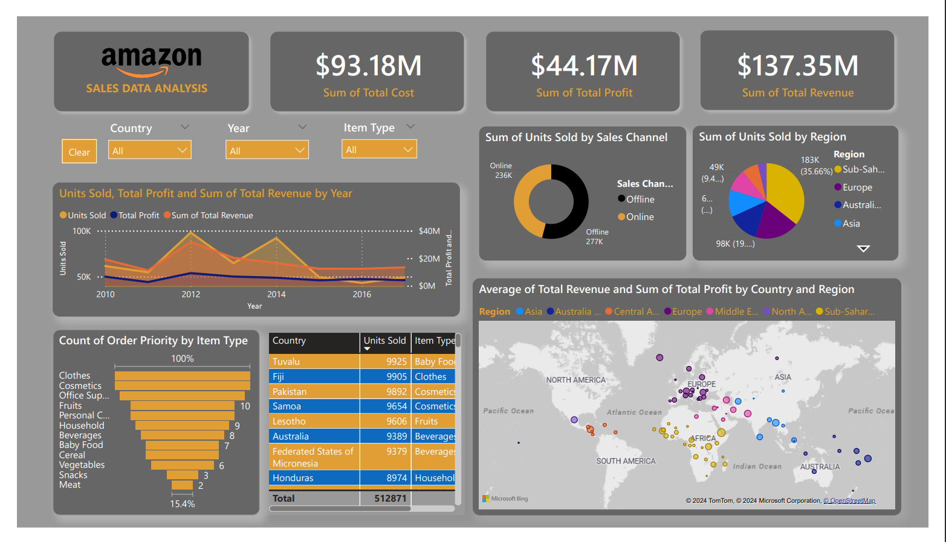

Slide 10
Conclusion
Summary:
Significant Sales in North America, Europe, and Asia.
Office Supplies and Household Items are top Sellers.
Notable sales peaks in 2012 and during certain months.

